Slide 1

ONLINE FOOD ORDERING SYSTEM
BY- RAGHAV BABBAR
VAIBHAV AGGARWAL

Slide 2
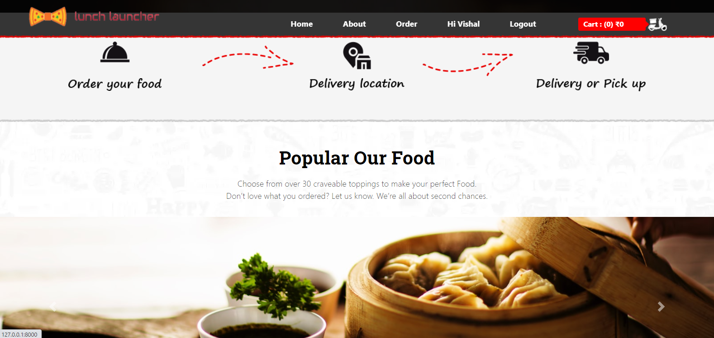
INTRODUCTION
The application is reduced as much as possible to avoid errors while entering the data. It also provides error message while entering invalid data. No formal knowledge is needed for the user to use this system. Thus, by this all it proves it is user-friendly. Online Food Ordering System, as described above, can lead to error free, secure, reliable and fast management system. It can assist the user to concentrate on their other activities rather to concentrate on the record keeping. Thus, it will help organization in better utilization of resources.
Every organization, whether big or small, has challenges to overcome and managing the information of Category, Food Item, Order, Payment, Confirm Order. Every Online Food Ordering System has different Food Item needs; therefore, we design exclusive employee management systems that are adapted to your managerial requirements. This is designed to assist in strategic planning and will help you ensure that your organization is equipped with the right level of information and details for your future goals. Also, for those busy executives who are always on the go, our systems come with remote access features, which will allow you to manage your workforce anytime, at all times. These systems will ultimately allow you to better manage resources.
The "Online Food Ordering System" has been developed to override the problems prevailing in the practicing manual system. This software is supported to eliminate and, in some cases, reduce the hardships faced by this existing system. Moreover, this system is designed for the particular need of the company to carry out operations in a smooth and effective manner.

Slide 3
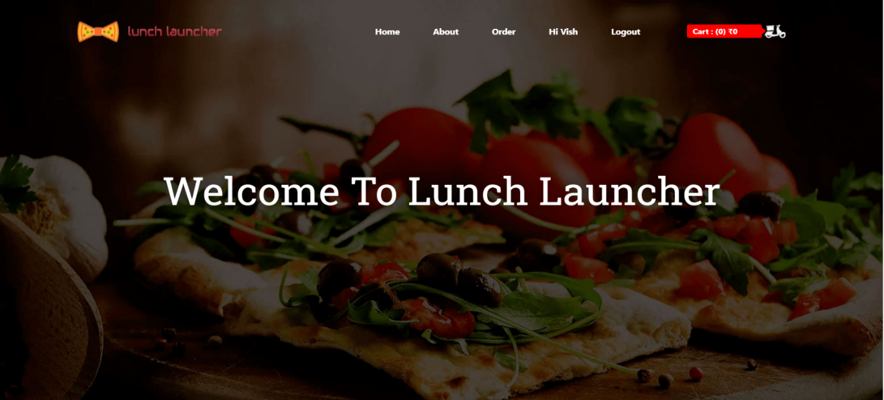
REQUIREMENTS
HARDWARE REQUIREMENT
Processor: Pentium-4 class processor or Above
RAM: 4GB of RAM or Above
Operating System: Windows XP or Above
SOFTWARE REQUIREMENT
Operating System: Windows XP or Above
Software: Visual Studio, XAMP
TECHNOLOGIES USED
FrontEnd: HTML5, CSS, JAVASCRIPT, BOOTSTRAP v4.5.3
Language: Python v3.71 with Django v2.0.13
Back End: MySQL

Slide 4
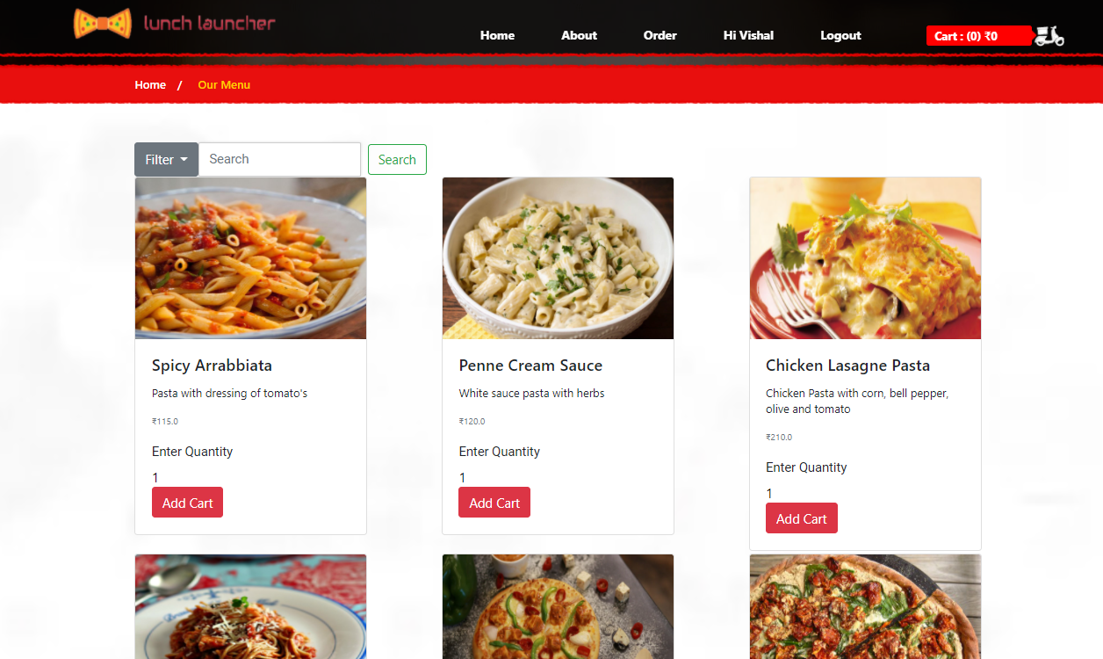
OBJECTIVE
Functionalities provided by Online Food Ordering System are as follows:
Provides the searching facilities based on various factors. Such as Food Item, Customer, Order, Confirm Order
Online Food Ordering System also manage the Payment details online for Order details, Confirm Order details, Food Item.
It tracks all the information of Category, Payment, Order etc
Manage the information of Category
Shows the information and description of the Food Item, Customer
To increase efficiency of managing the Food Item, Category
It deals with monitoring the information and transactions of Order.
Manage the information of Food Item
Editing, adding and updating of Records is improved which results in proper resource management of Food Item data.
Manage the information of Order
Integration of all records of Confirm Order.
The main objective of the Project on Online Food Ordering System is to manage the details of Food Item, Category, Customer, Order, Confirm Order. It manages all the information about Food Item, Payment, Confirm Order, Food Item. The project is totally built at administrative end and thus only the administrator is guaranteed the access. The purpose of the project is to build an application program to reduce the manual work for managing the Food Item, Category, Payment, Customer. It tracks all the details about the Customer, Order, Confirm Order.

Slide 5
FEATURES
Admin Aspect:
Add/update/view/delete Menu with their details in database
Visitor:
View Menu added by admin
User:
View Menu added by admin
View/update tracking
Logging/log out the system
View order details
Register
Contact for query
Give feedbacks
Contact for query
Place order
Payment
Track
Logging/log out the system

Slide 6
DIAGRAMS

Slide 7
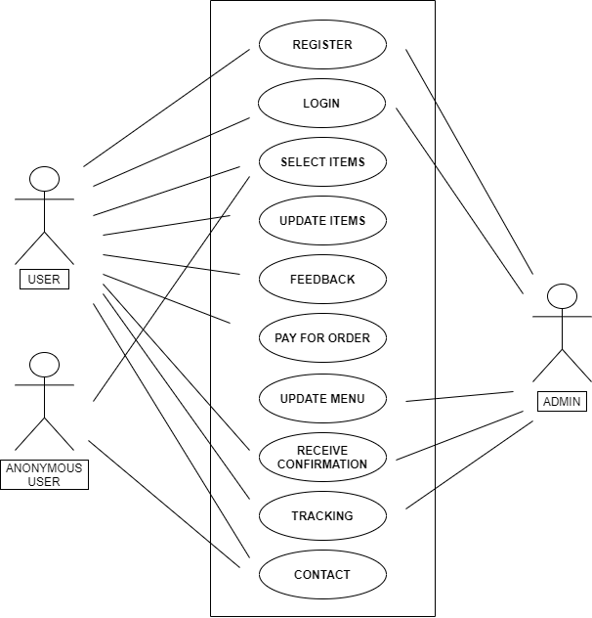
USE CASE DIAGRAM

Slide 8
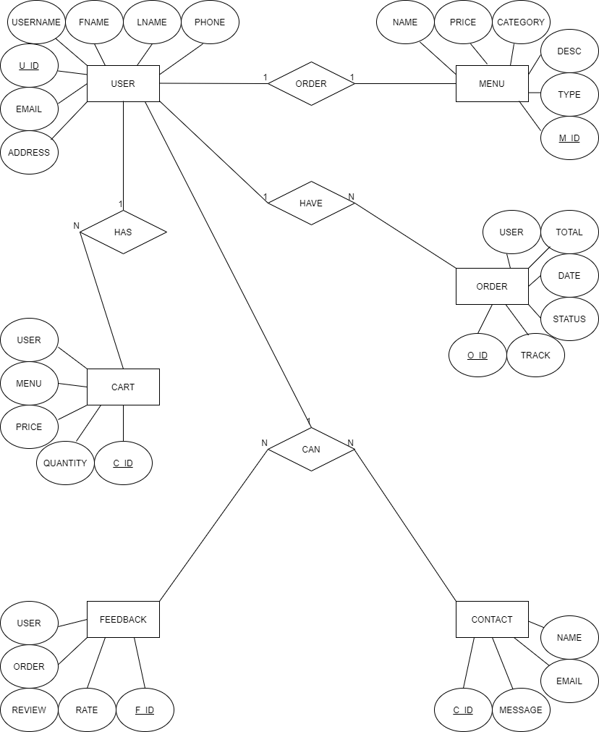
ENTITY RELATIONSHIP DIAGRAM

Slide 9
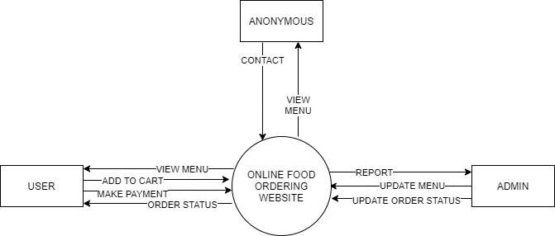
Data Flow Diagram Level-0

Slide 10
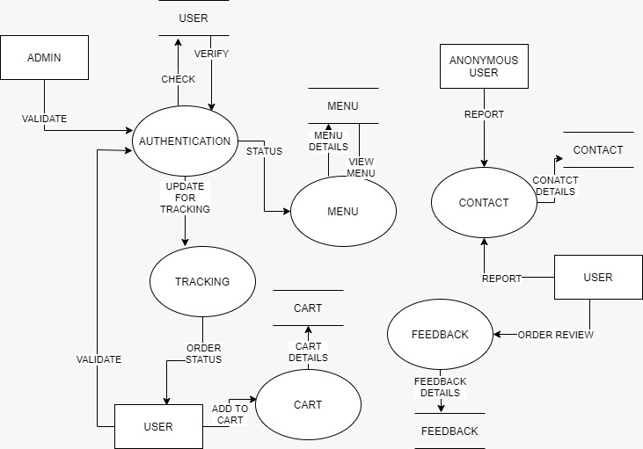
Data Flow Diagram Level-1

Slide 11
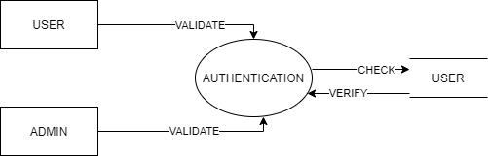
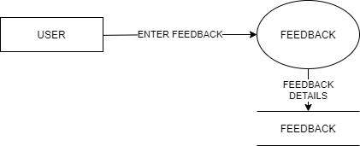
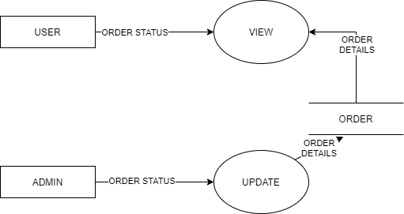
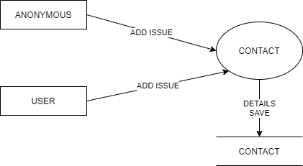
Data Flow Diagram Level-2
Authentication
Feedback
Tracking
Contact

Slide 12
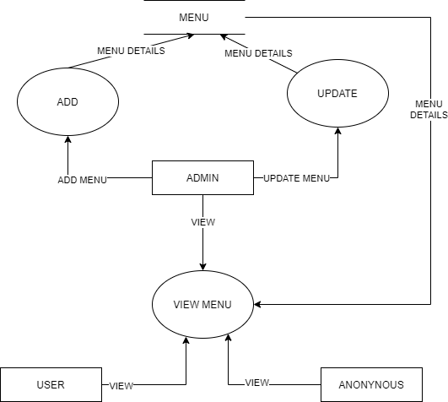
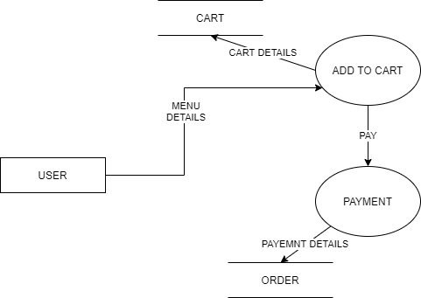
Data Flow Diagram Level-2
Menu
Order

Slide 13
SCREENSHOTS

Slide 14
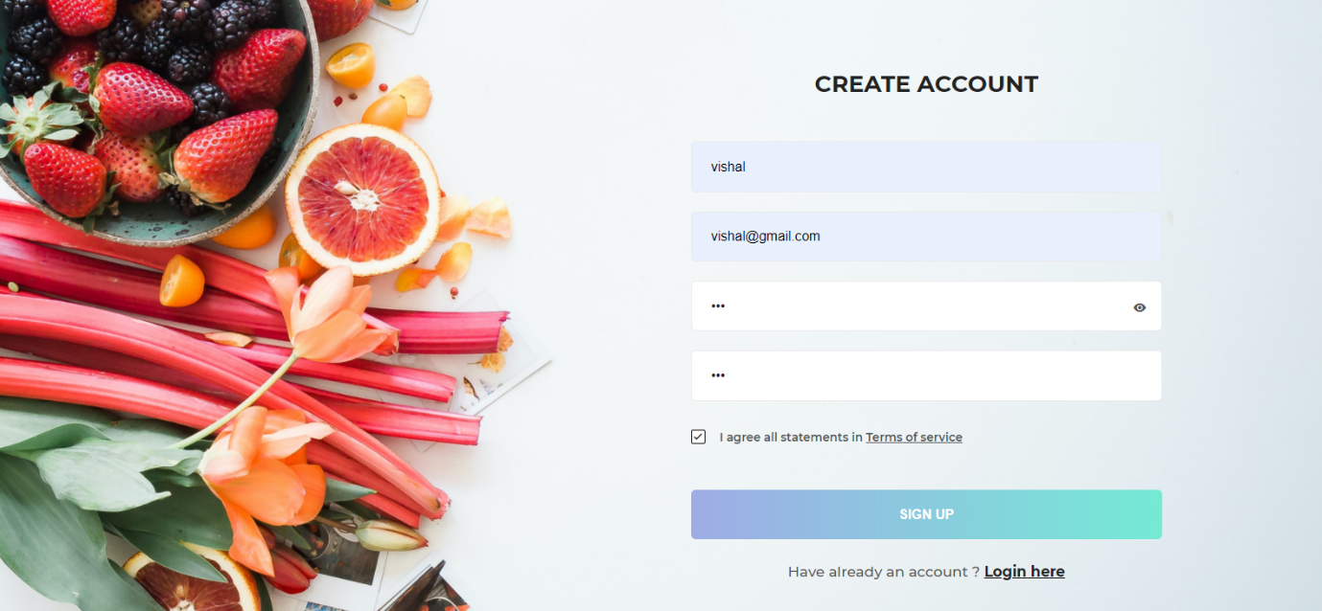
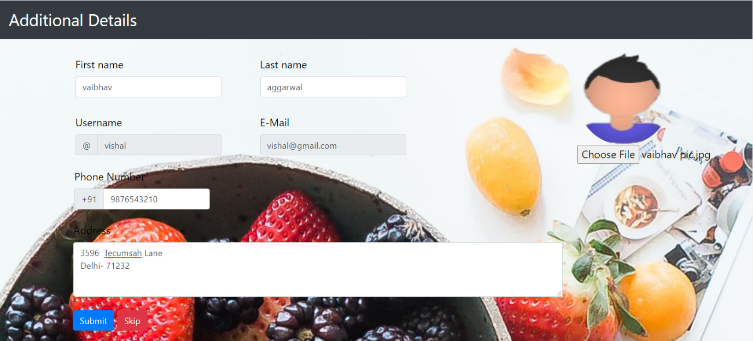
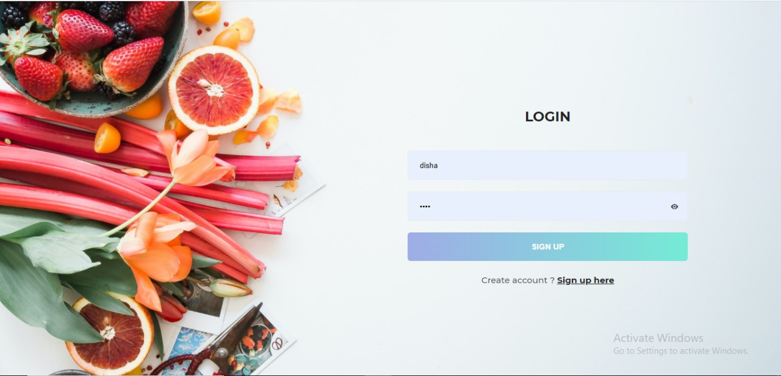
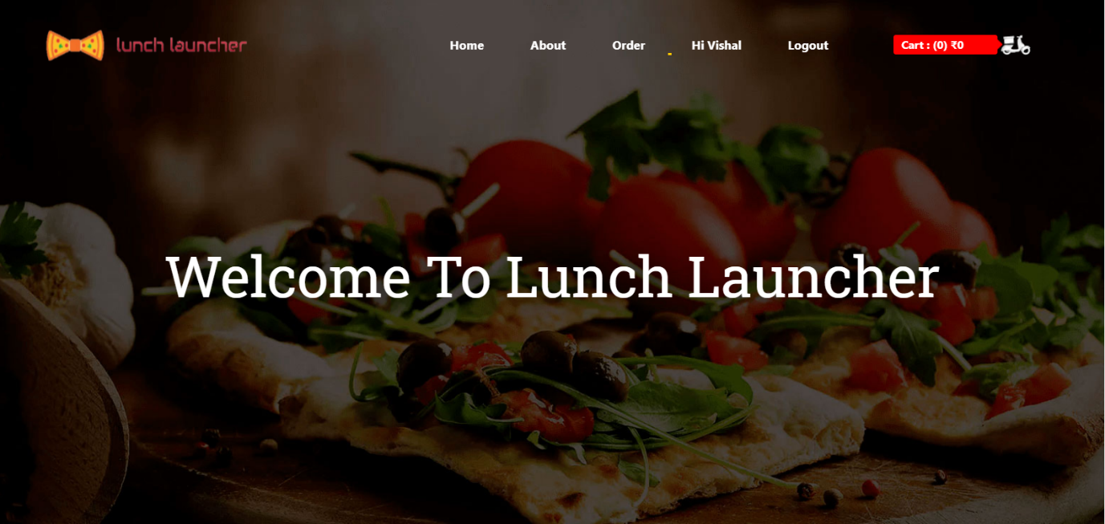

Slide 15
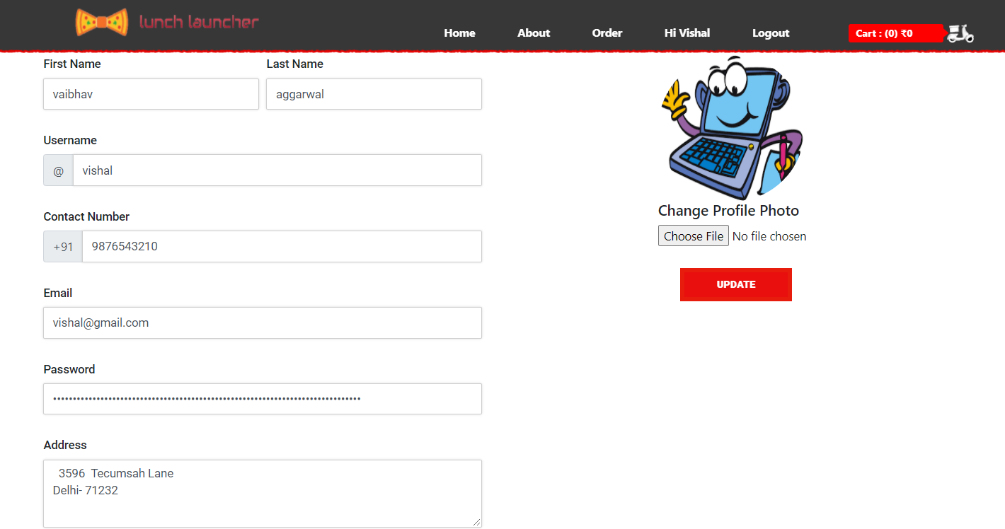
Home Page
Profile Page

Slide 16
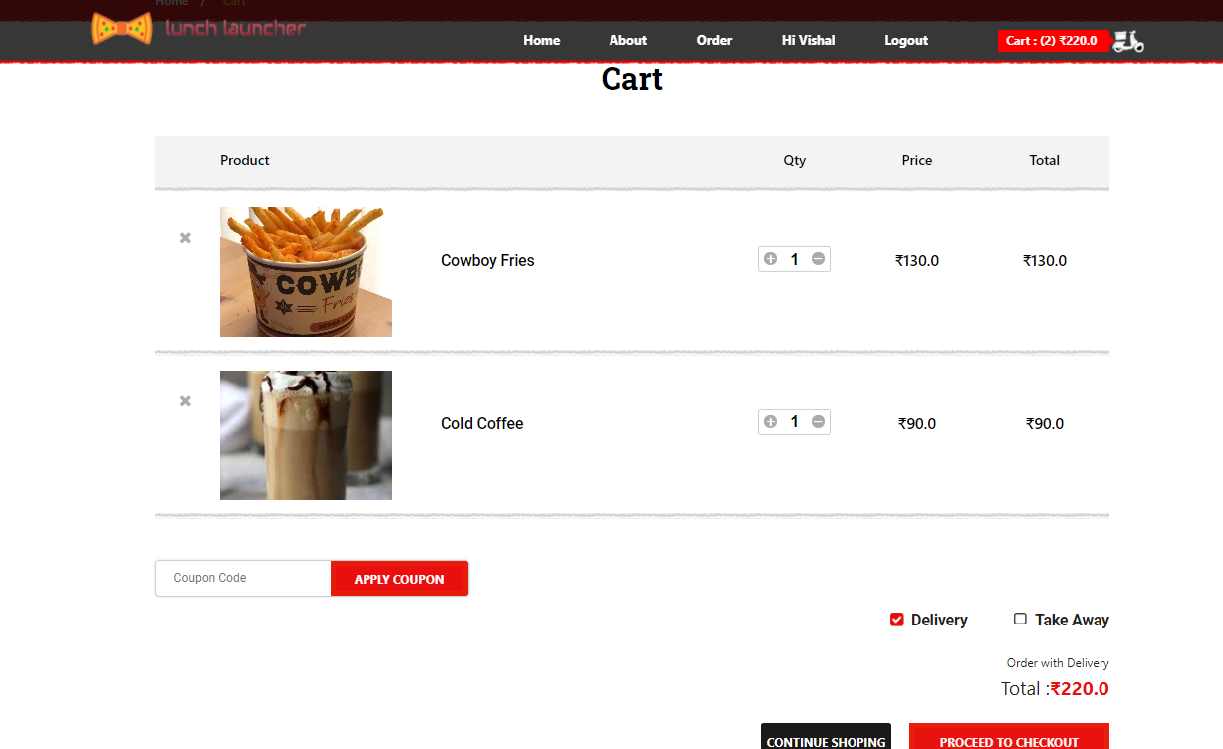
Menu Page
Cart Page

Slide 17
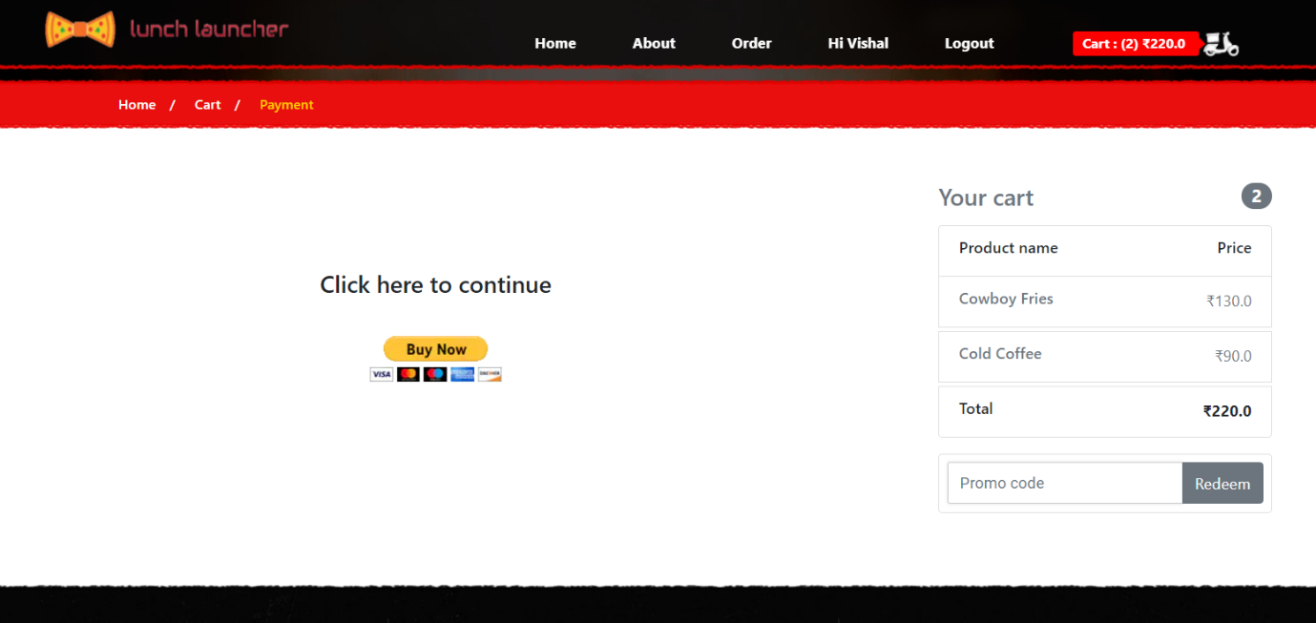
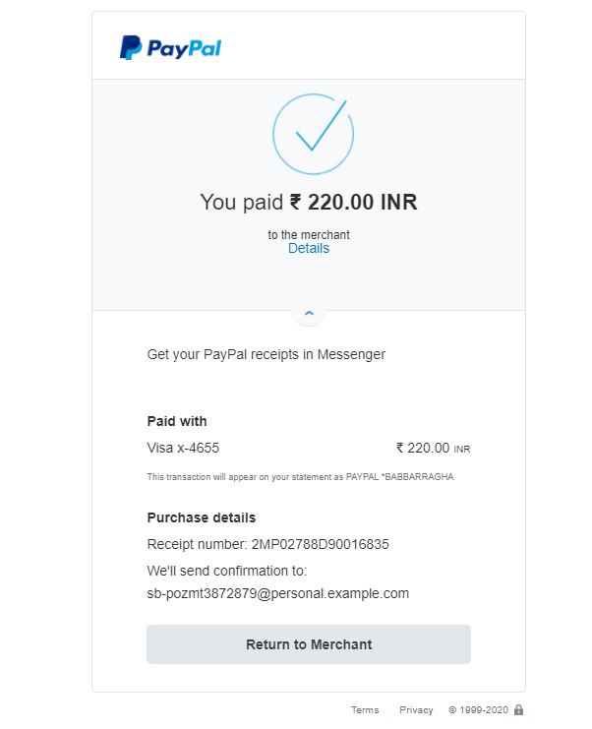
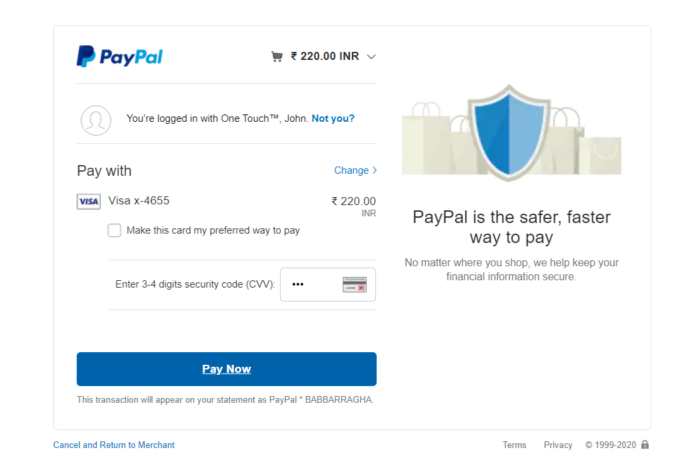

Slide 18
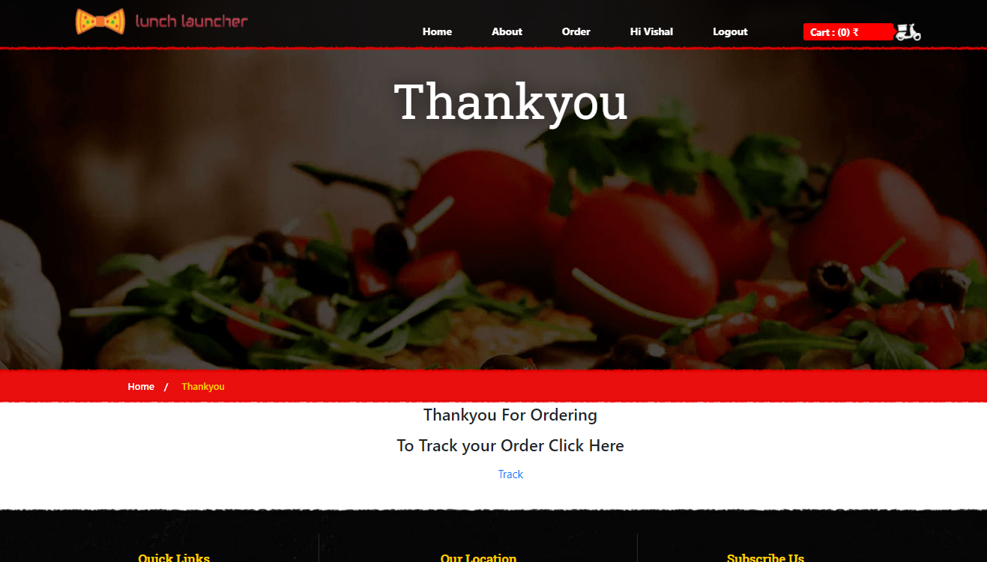
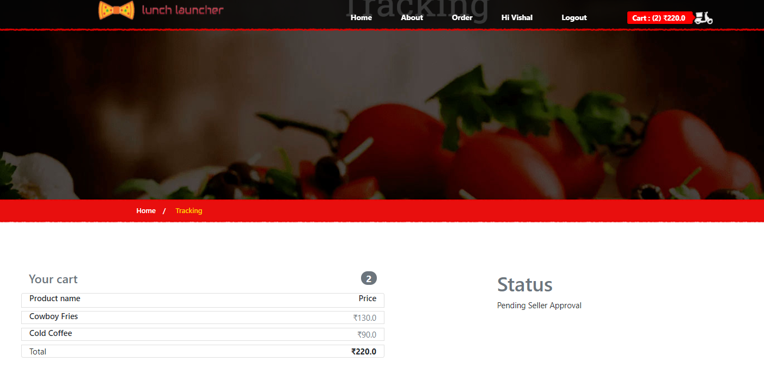
Thank You
Page
Tracking
Page

Slide 19
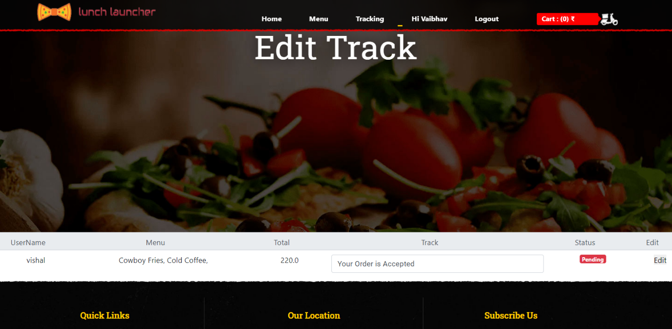
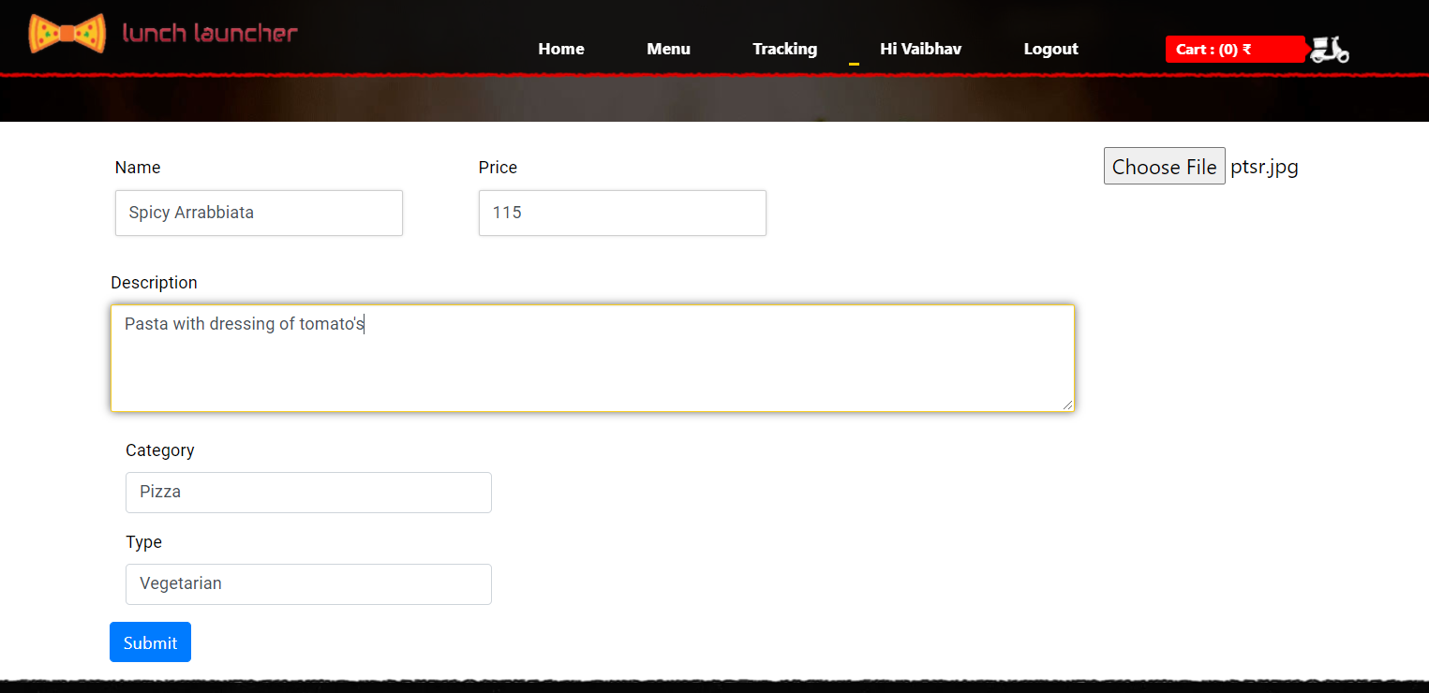
Edit Track
Page
Add Menu
Page

Slide 20
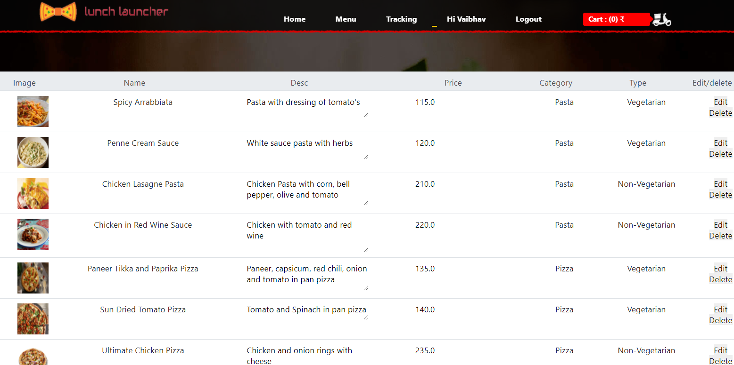
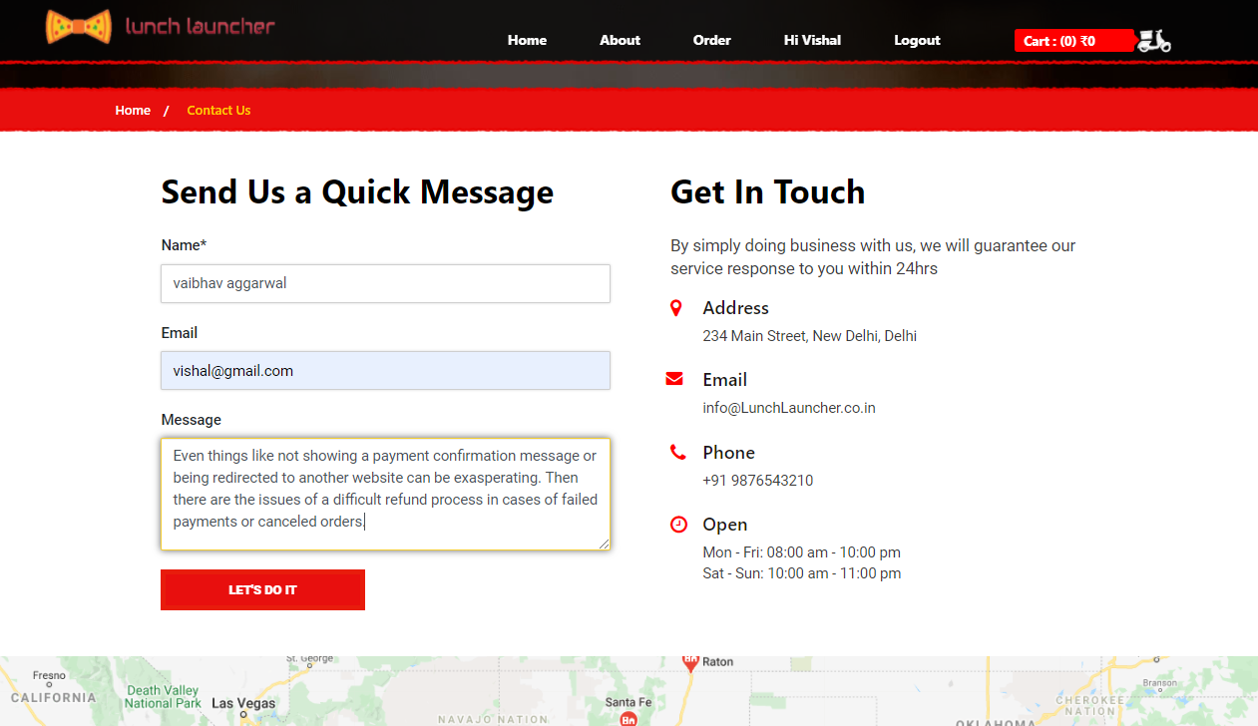
Edit Menu
Page
Contact Page

Slide 21
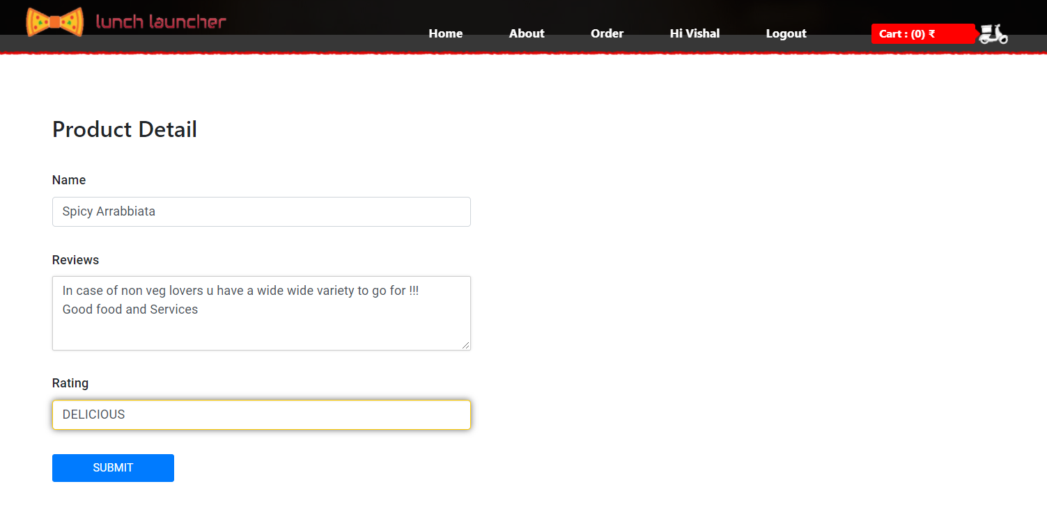
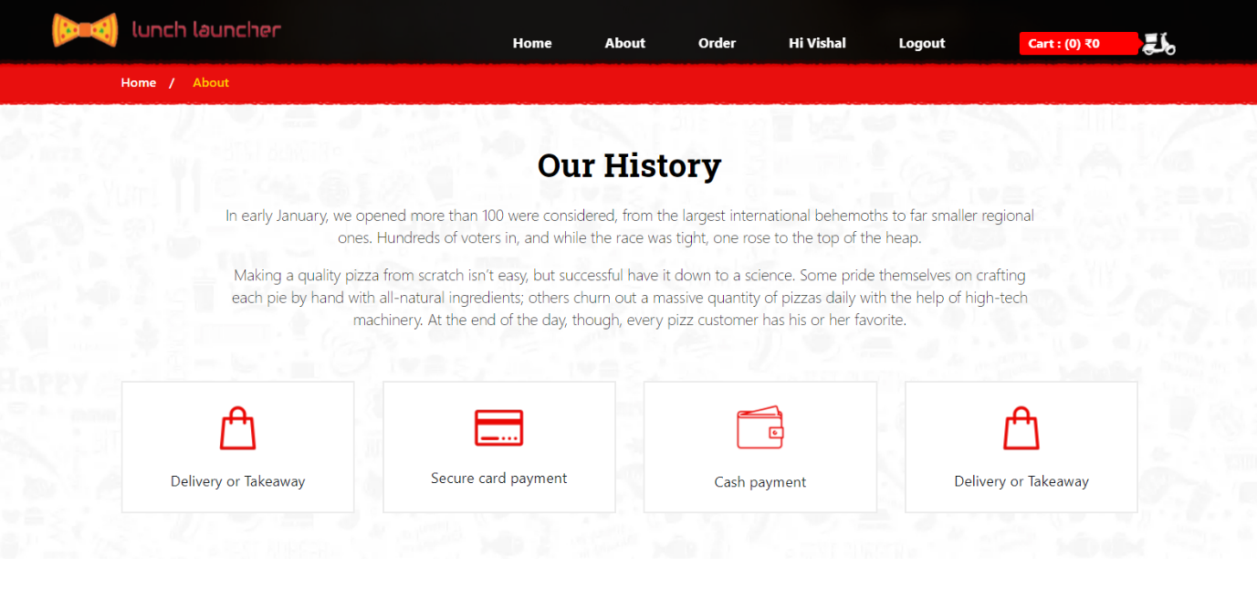
Feedback
Page
About Page

Slide 22
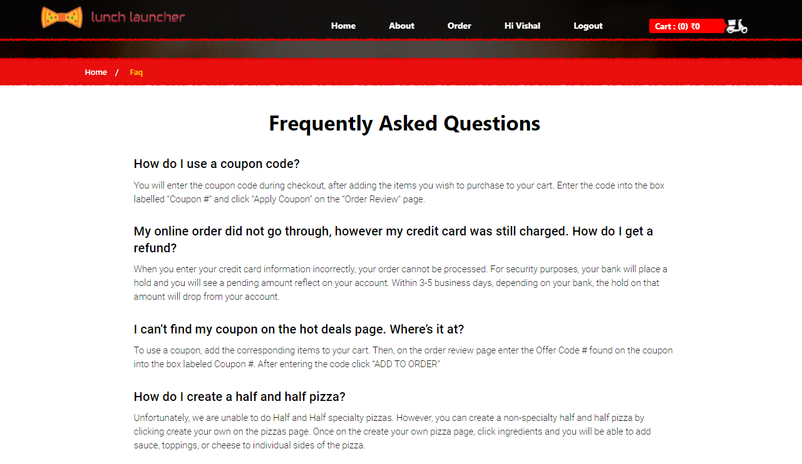
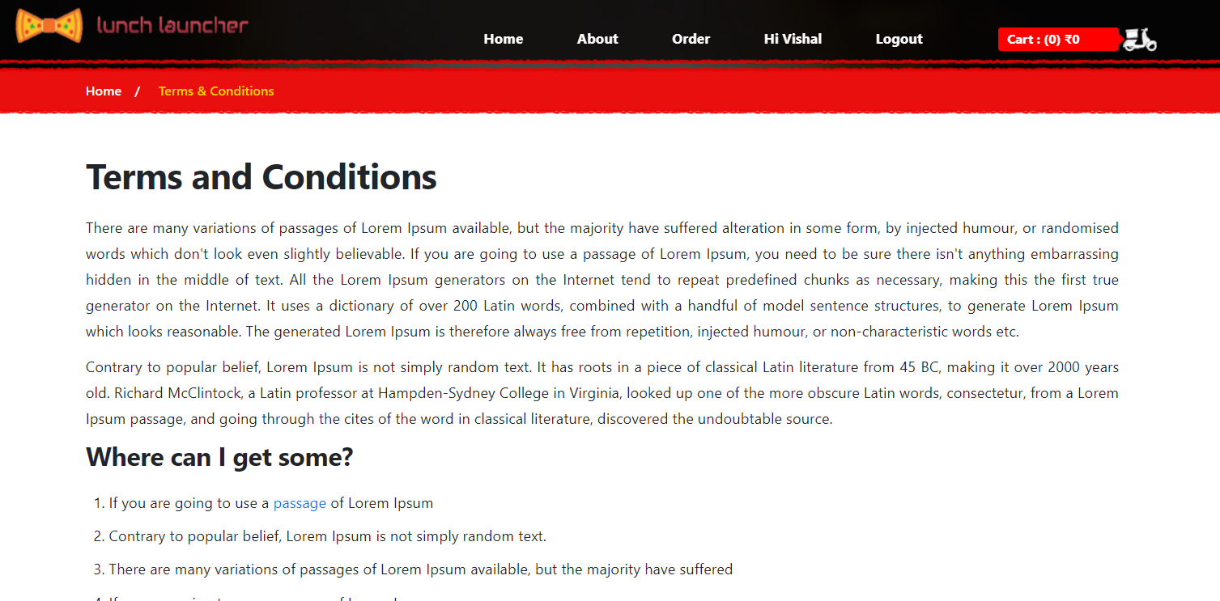
Frequently Asked
Questions
Page
Terms & Condition
Page

Slide 23
CONCLUSION
An online food ordering system is developed where the customers can make an order for the food and avoid the hassles of waiting for the order to be taken by the waiter. Using the application, the end users register online, read the E-menu card and select the food from the e-menu card to order food online. Once the customer selects the required food item the admin will be able to see the results on the screen and start processing the food. This application nullifies the need of a waiter or reduces the workload of the waiter. The advantage is that in a crowded restaurant there will be chances that the waiters are overloaded with orders and they are unable to meet the requirements of the customer in a satisfactory manner. Therefore, by using this application, the users can directly place the order for food online.
In conclusion an online food ordering system is proposed which is useful in small family run restaurants as well as in places like college cafeteria, etc. This project can later be expanded on a larger scale. It is developed for restaurants to simplify their routine managerial and operational task and to improve the dining experience of the clients. This also helps the restaurant owners develop healthy customer relationships by providing reasonably good services. The system also enables the restaurant to know the items available in real time and make changes to their food and beverage inventory based on the orders placed and the orders completed.

Slide 24
FUTURE SCOPE
In short, it can be summarized that the future scope of the project circles around maintaining information regarding:
We can add payment slips in future.
We can give more advance software for Online Food Ordering System including more facilities.
We will host the platform on online servers to make it accessible worldwide.
Integrate multiple load balancers to distribute the loads of the system.
Create the master and slave database structure to reduce the overload of the database queries.
Implement the backup mechanism for taking backup of codebase and database on regular basis on different servers.
The above-mentioned points are the enhancements which can be done to increase the applicability and usage of this project. Here we can maintain the records of Food Item and Category. Also, as it can be seen that now-a-days the players are versatile, i.e., so there is a scope for introducing a method to maintain the Online Food Ordering System. Enhancements can be done to maintain all the Food Item, Category, Customer, Order, Confirm Order.
We have left all the options open so that if there is any other future requirement in the system by the user for the enhancement of the system then it is possible to implement them. In the last we would like to thanks all the persons involved in the development of the system directly or indirectly. We hope that the project will serve its purpose for which it is develop there by underlining success of process.

Slide 25
REFERENCES
https://docs.djangoproject.com/en/3.1/
https://developer.paypal.com/docs/archive/checkout/integrate/
https://getbootstrap.com/docs/5.0/getting-started/introduction/
https://www.scribd.com/
https://books.goalkicker.com/PythonBook/
https://developer.mozilla.org/en-US/docs/Web/CSS/Reference/

Slide 26
THANK YOU

